Slide 1

Unit 3
Arrays ,Strings and Functions

Slide 2
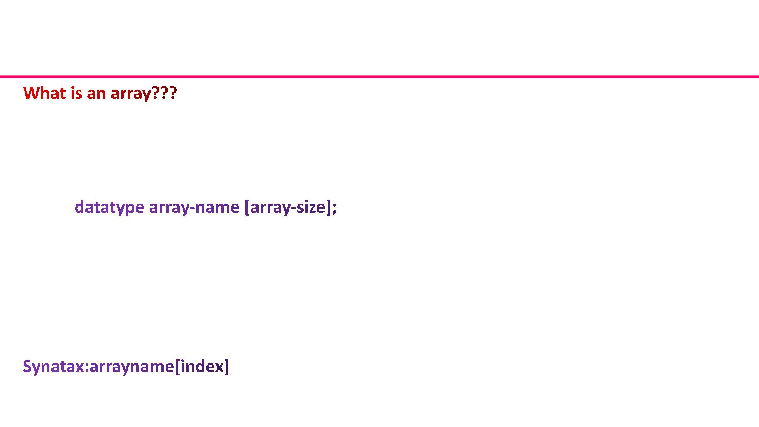
Array
It is a collection of multiple elements belonging to the same data type occupying continuous
memory locations and referred to by the same name.
Array Declaration
Syntax:
Example:
int marks[120];
Array index starts from 0 .if an array to store 100 elements is required then
a[0] to a[99]
Accessing an array element
Using array name and the corresponding index
Example:
a[9] will access the 10th element

Slide 3
Array
Initialising an Array
Method 1:
int marks[5] = {100, 20, 34, 17, 50};
marks[0]=100,marks[1]=20,marks[2]=34,marks[3]=17 marks[4]=50
The number of values between braces { } cannot be larger than the number of elements
that we declare for the array between square brackets [ ].
Method 2:
int marks[ ] = {10, 20, 34, 17, 50};
will create exactly an array of size 5.
Method 3:
int marks[0]=100,int marks[1]=20,int marks[4] = 50;
This 5th element of the array is assigned with a value 5.
Method 4:
Can be initialised at runtime by accepting input from the user-scanf()(with the use of loops)

Slide 4
Types of Array
ONE DIMENSIONAL ARRAYS
Declaration Syntax:
datatype array-name [array-size];
This is called a single-dimensional array or one dimensional array. The array-size must be an
integer constant greater than zero and datatype can be any valid C data type.
For example, to declare a 10-element array called marks of type int, use this statement:
int marks[10];
Now marks is an array which is sufficient to hold up to 10 integer numbers.
A character array of size 10 can be char arr[10];
and a float array of size 10 can be float farr[10];

Slide 5
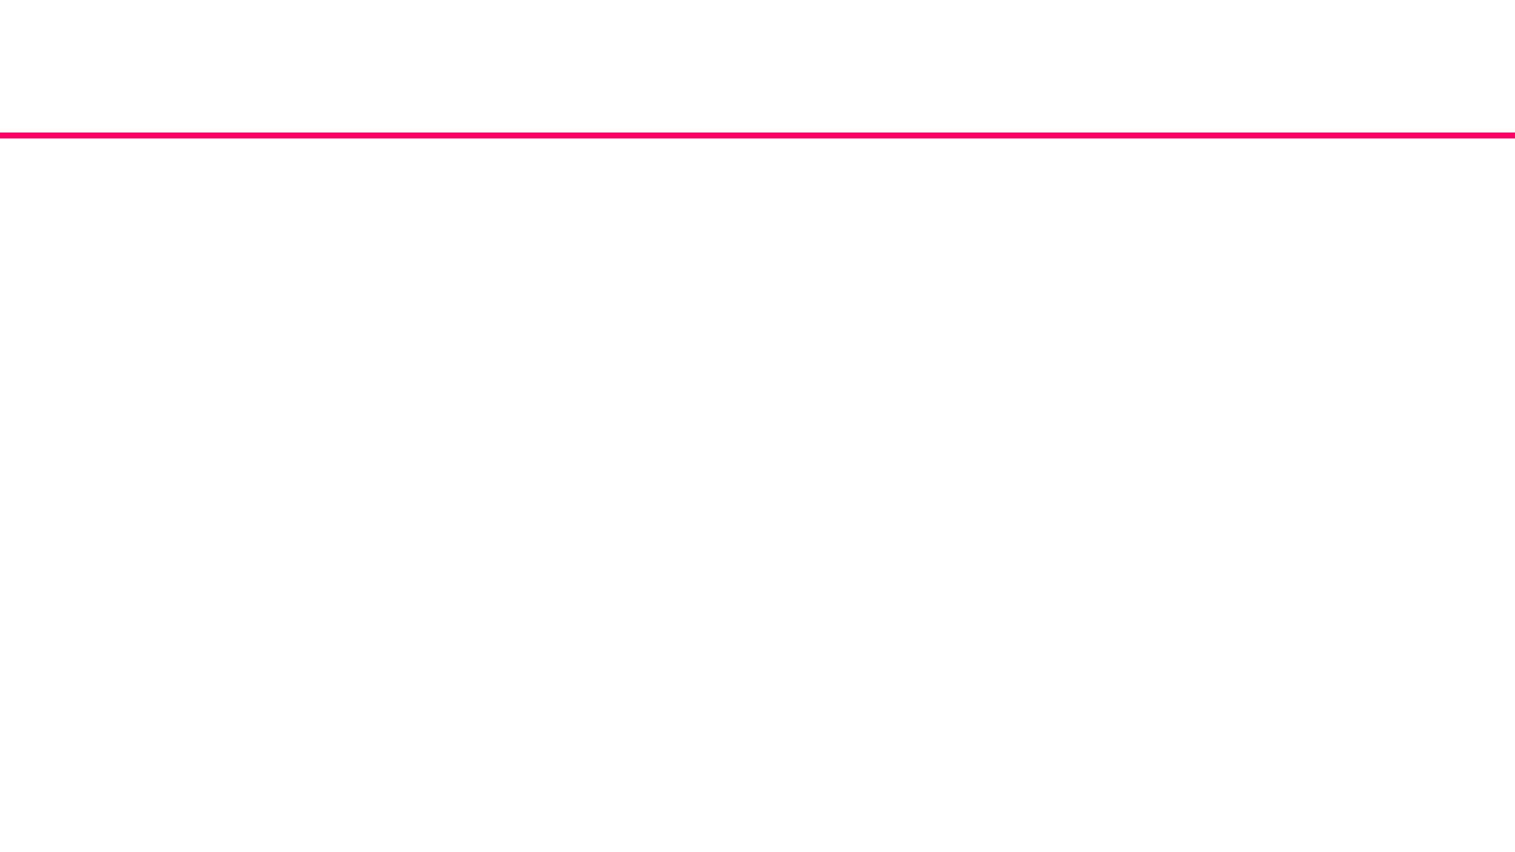
Types of Array (Contd..)
TWO DIMENSIONAL ARRAYS
A two-dimensional array is a collection of elements, all of the same type, structured in two
dimensions. Each element is accessed by a pair of indices that represent the element's position
in each dimension.
Declaration Syntax:
datatype array-name[row-size][column-size]
Where datatype can be any valid C data type and array-name will be a valid C identifier. A two
dimensional array can be thought as a table which will have x number of rows and y number of
columns.

Slide 6
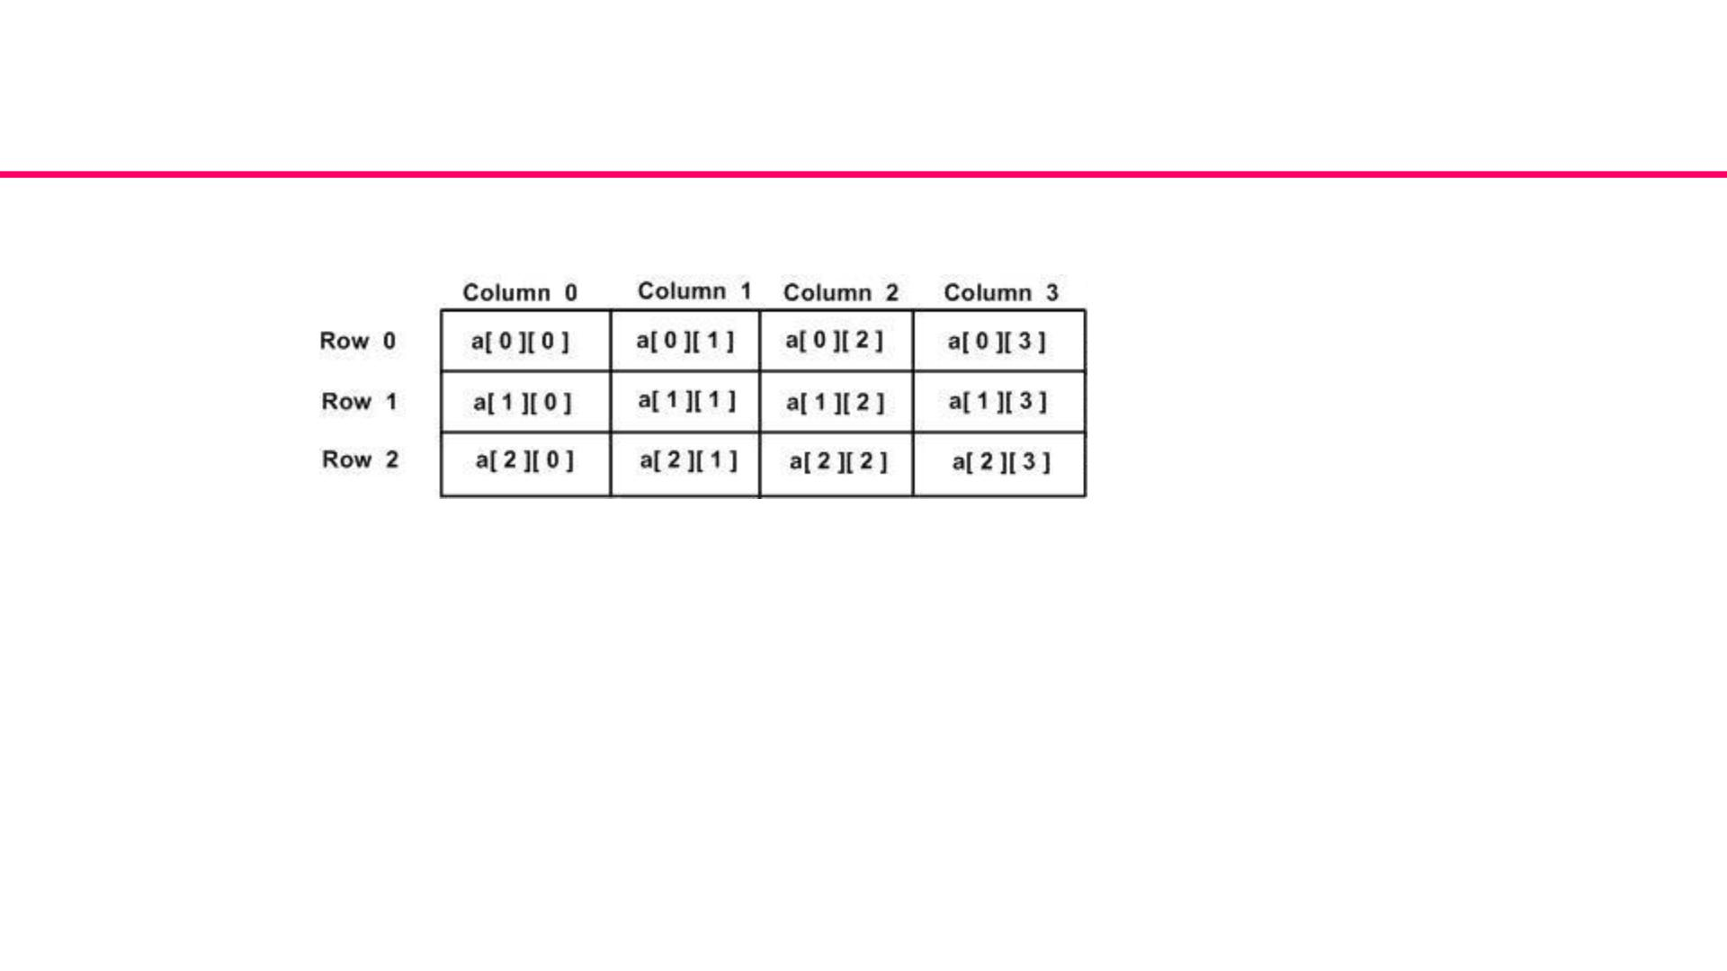
TWO DIMENSIONAL ARRAYS(Contd..)
Element in array a is identified by an element name of the form a[ i ][ j ], where a
is the name of the array, and i and j are the subscripts that uniquely identify each
element in array a.

Slide 7
TWO DIMENSIONAL ARRAYS(Contd..)
Initializing Two-Dimensional Arrays:
Method 1:
Two dimensional arrays may be initialized by specifying bracketed values for each row.
Following is an array with 3 rows and each row have 4 columns.
int a[3][4] = { {0, 1, 2, 3},{4, 5, 6, 7},{8, 9, 10, 11} };
The nested braces, which indicate the intended row, are optional.
The following initialization is equivalent to previous one:
int a[3][4] = {0,1,2,3,4,5,6,7,8,9,10,11};
Method 2:
Array can be initialized by taking input from user at run time using loops.
for(i=0;i<3;i++)
for(j=0;j<4;j++)
scanf(“%d”,&a[i][j]);

Slide 8
TWO DIMENSIONAL ARRAYS(Contd..)
Accessing Two-Dimensional Array Elements:
An element in 2-dimensional array is accessed by using the subscripts ie. row index and
column index of the array.
For example:
int val = a[2][3];
The above statement will take 4th element from the 3rd row of the array.

Slide 9
Types of Array (Contd..)
MULTI DIMENSIONAL ARRAYS
More than two dimensions is also possible. It is a Collection of elements, all of the same
type and having the same name, ordered on N dimensions (N>1). Each element is accessed
by N indicies, each of which represents the element's position within that dimension.
Declaration Syntax:
data_type array-name[s1] [s2] [s3].........[sn];
where si is the size of the ith dimension. .n-dimensional array will have n subscripts
therefore n looping statements.

Slide 10
MULTI DIMENSIONAL ARRAYS(Contd..)
MULTI DIMENSIONAL ARRAYS
Declaration Syntax:
data_type array-name[s1] [s2] [s3].........[sn];
where si is the size of the ith dimension. .n-dimensional array will have n subscripts
therefore n looping statements.
Example : Consider a series of department stores (10 stores). Monthly total sales figures
must be kept for each item by store. Assuming the store sells 50 different items. We can
define an array as:
int sales[ 10 ] [ 50 ][ 12 ];
to keep track of the total sales every month.

Slide 11
Searching
Searching operation is to find an element in an array. The searching operations is performed in two ways.
1.Linear search (Sequential search)
2.Binary search
Linear search
* Linear search is the simplest search algorithm.
*In this type of search, a sequential search is made over all items one by one.
*Every item is checked and if a match is found then that particular item is returned, otherwise the search continues till the end of the data collection.

Slide 12
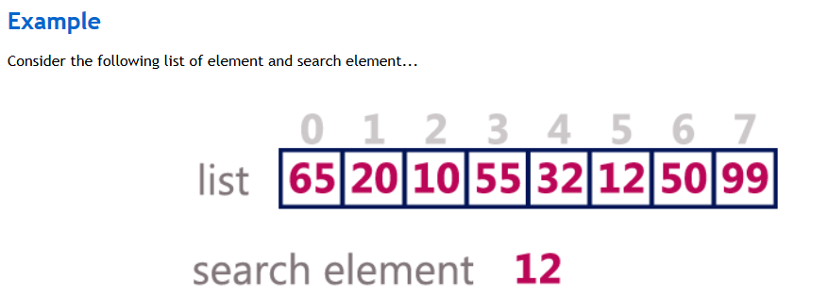
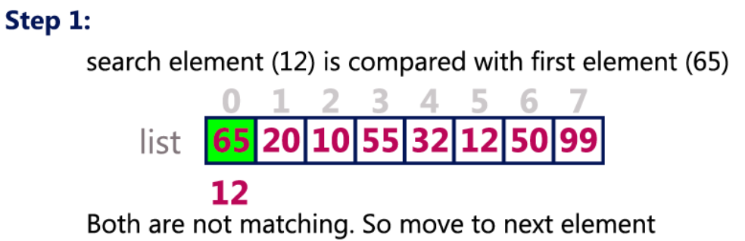

Slide 13
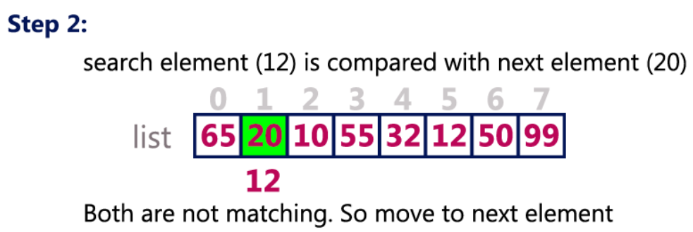
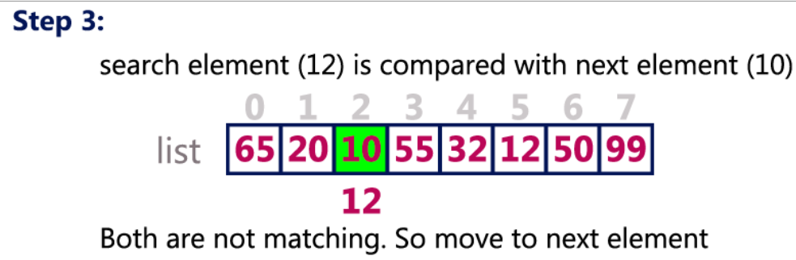

Slide 14
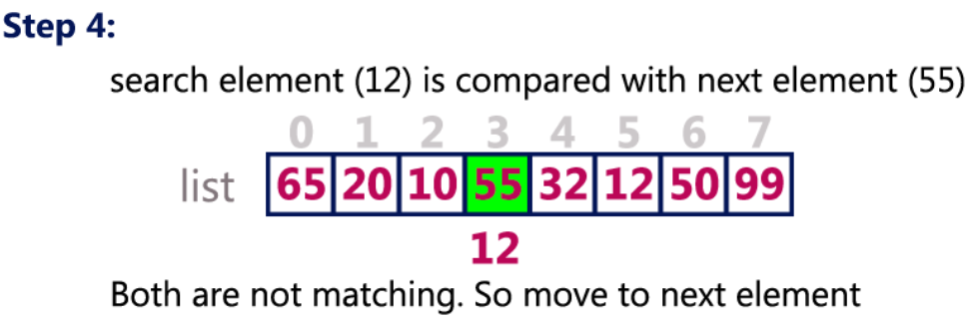
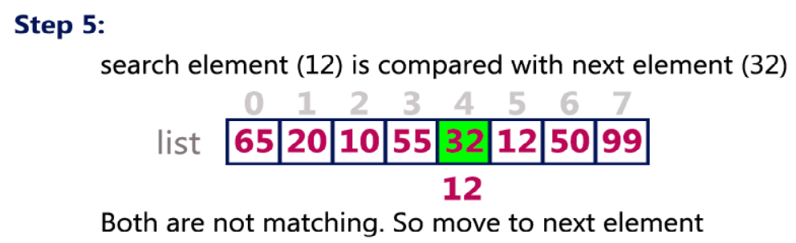

Slide 15
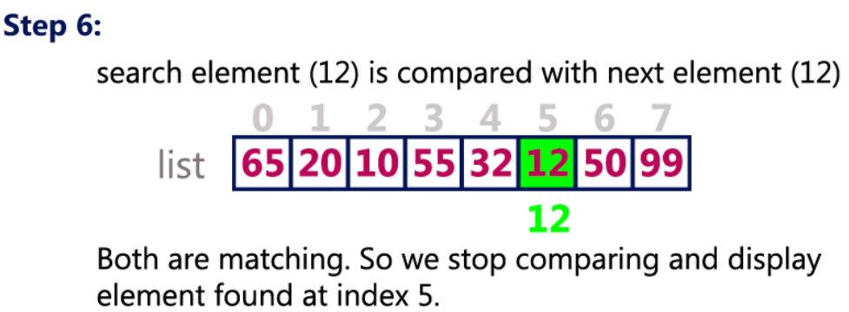

Slide 16
Algorithm
A is an array of N elements
ITEM is element to be searched
i is the counter
Step1: set i=0; flag=1;
Step2: repeat step3 and step 4 while(i<N)
Step3: if a[i]==item
flag=0;
Output search successful and element found at i+1 position
go to step6
Step 4: set i=i+1
Step 5: if (flag ==0)
Output search successful
Step6: Exit

Slide 17
Tracing
Let a[5] = {10,20,30,40,50} N=5, Item =30
Step1: set i=0; flag=1;
Step2: repeat step3 and step 4 while(0<5)
Step3: if a[0]==30 10==30 //false
Step 4: set i=i+1 i=0+1=1
Step2: repeat step3 and step 4 while(1<5)
Step3: if a[1]==30 20==30 //false
Step 4: set i=i+1 i=1+1=2
Step2: repeat step3 and step 4 while(2<5)
Step3: if a[2]==30 30==30 //true
flag=0;
Output search successful and element found at i+1 position
go to step6
Step6: Exit

Slide 18
search for the largest and smallest element in an array of integers using sequential search
Algorithm
Step1: Start
Step2: Read the size of the array
Step3: Read the array elements
Step4: Initialize large=a[0],small=a[0]
Step 5: Repeat the following steps 6 and 7 for i=1 to n
Step6:If a[i]>large
large=a[i]
End if
Step 7: If a[i]<small
small=a[i]
End if [end for]
Step 8:Print large and small
Step 9: Stop

Slide 19
Program to search for the largest and smallest element in an array of integers using sequential search*/
#include <stdio.h>
void findMinMax(int arr[], int size, int *min, int *max)
{
*min = *max = arr[0];
for (int i = 1; i < size; ++i) {
if (arr[i] < *min) *min = arr[i];
if (arr[i] > *max) *max = arr[i];
}
}
int main() {
int size;
printf("Enter the size of the array: ");
scanf("%d", &size);
int arr[size];
printf("Enter %d elements:\n", size);
for (int i = 0; i < size; ++i) scanf("%d", &arr[i]);
int min, max;
findMinMax(arr, size, &min, &max);
printf("Minimum element: %d\nMaximum element: %d\n", min, max);
return 0;
}

Slide 20
Enter the size of the array: 8
Enter 8 integers: 15 7 23 11 5 9 16 13
int size;
printf("Enter the size of the array: ");
scanf("%d", &size);
The user inputs a size of 8 for the array.
int arr[size];
printf("Enter %d integers:\n", size);
for (int i = 0; i < size; scanf("%d", &arr[i++]));
The user inputs the array elements: 15, 7, 23, 11, 5, 9, 16, 13.
int min, max;
findMinMax(arr, size, &min, &max); The function findMinMax is called with the array arr, its size size, and pointers to min and max.

Slide 21
void findMinMax(int arr[], int size, int *min, int *max) {
*min = *max = arr[0];
for (int i = 1; i < size; i++) {
if (arr[i] < *min) *min = arr[i];
if (arr[i] > *max) *max = arr[i];
}
}
min and max are initialized with the first element of the array, i.e., 15.
The function iterates through the array. For each element, it updates min if the element is smaller than the current min, and updates max if the element is larger than the current max.
printf("The smallest element is: %d\n", min);
printf("The largest element is: %d\n", max);
The program prints the smallest and largest elements:
The smallest element is: 5
The largest element is: 23
In this example, the smallest element in the array is 5, and the largest element is 23, as determined by the program.

Slide 22
Bubble Sort
To Remember
Compare adjacent elements ..if first element is greater than second
element swap them otherwise continue with next comparison.
After each pass one element will come to its position in sorted list.

Slide 23
Bubble sort
Bubble Sort is an algorithm which is used to sort N elements that are given in a memory .
For eg: an Array with N number of elements. Bubble Sort compares all the element one by one and sort them based on their values.
Sorting takes place by stepping through all the data items one-by-one in pairs and comparing adjacent data items and swapping each pair that is out of order.
Example
We take an unsorted array

Slide 24
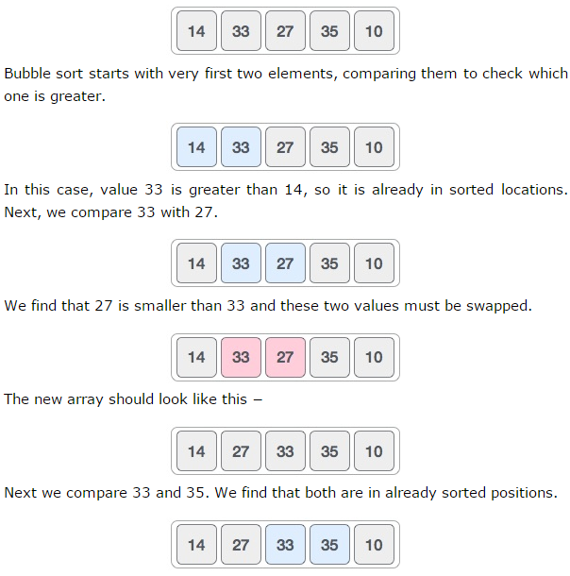

Slide 25
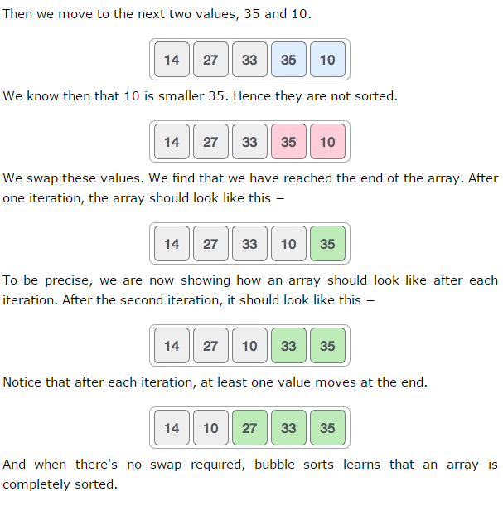

Slide 26
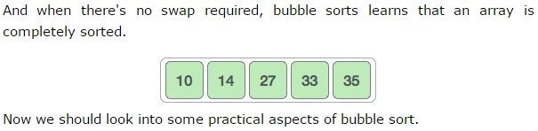

Slide 27
Algorithm
A is an array of n elements. The variable i and j are used to index the array elements.
Step1: Start
Step2: Read the size of the array in to variable n
Step3: Read the array elements
Step4: Repeat the following steps 5 and 6 for i=0 to n-1
Step 5: Repeat step 6 for j=0 to n-i-1
Step 6: If (a[j]>=a [j+1])
Swap a[j] with a[j+1]
[End if]
[end of step 4 for loop]
[end of step 5 for loop]
Step 7: print the sorted list
Step 8: Stop

Slide 28
Program
int a[6] = {5, 1, 6, 2, 4, 3};
int i, j, temp;
for(i=0; i<n-1; i++)
{
for(j=0; j<n-i-1; j++)
{
if( a[j] > a[j+1])
{
temp = a[j];
a[j] = a[j+1];
a[j+1] = temp;
} } }

Slide 29
Example:
Let us take the array of numbers 5 1 4 2 8 and sort the array in ascending order using bubble sort algorithm. In each step, elements written in bold are being compared.
Pass 1: ( 5 1 4 2 8 ) ( 1 5 4 2 8 ), Here, algorithm compares the first two elements, and
swaps them , since 5>1. ( 1 5 4 2 8 ) ( 1 4 5 2 8 ), Swap since 5 > 4 ( 1 4 5 2 8 ) ( 1 4 2 5 8 ), Swap since 5 > 2 ( 1 4 2 5 8 ) ( 1 4 2 5 8 ), Now, since these elements are already in order (5<8),
algorithm does not swap them. After pass 1 , 8 has come to its position Pass 2:
( 1 4 2 5 8 ) ( 1 4 2 5 8 ) No Swap since1<4 ( 1 4 2 5 8 ) ( 1 2 4 5 8 ), Swap since 4 > 2 ( 1 2 4 5 8 ) ( 1 2 4 5 8 ) , No Swap since4<5 ( 1 2 4 5 8 ) ( 1 2 4 5 8 ) Now, the array is already sorted, but our algorithm does not know if it is completed. The algorithm needs one whole pass without any swap to know it is sorted. After pass 2 , 5 has come to its position and 2 elements are arranged. Pass 3:
( 1 2 4 5 8 ) ( 1 2 4 5 8 ) No Swap since1<2 ( 1 2 4 5 8 ) ( 1 2 4 5 8 ) No Swap since2<4
After pass 3, 4 has come to its position and 3 elements are sorted.
Pass 4:
( 1 2 4 5 8 ) ( 1 2 4 5 8 ) No Swap since1<2 After pass 4, 2 has come to its position and 4 elements are sorted.
Finally, the array is sorted, and the algorithm can terminate.

Slide 30
//Program to sort a list of N elements using Bubble Sort
#include<stdio.h>
void main()
{
int n,i,j,temp,a[100];
clrscr();
printf("\nEnter the size of array :");
scanf("%d",&n);
printf("\n Enter the elements\n");
for(i=0;i<n;i++)
{
scanf("%d",&a[i]);
}
printf("Entered array is\n");

Slide 31
for(i=0;i<n;i++)
{
printf("%d\t",a[i]);
}
for(i=0;i<n-1;i++)
{
for(j=0;j<n-i-1;j++)
{
if(a[j]>=a[j+1])
{
temp=a[j];
a[j]=a[j+1];
a[j+1]=temp;
}
}
}

Slide 32
printf("\nThe sorted array\n");
for(i=0;i<n;i++)
{
printf("%d\t",a[i]);
}
getch();
}

Slide 33
STRINGS
A string is a sequence of characters terminated with a null character \0
vA string is stored in a one-dimensional character type array.
vEach character within the string is stored as an element of the array in contiguous
memory locations.
vThe strings are terminated with a null character ’\0’.
vTo store a string of n characters, you require a character array of n+1 size

Slide 34
String - Declaration
Syntax:char array-name[size];
Example
char name[5];
It reserves 20 bytes of contiguous locations to store the
characters.

Slide 35
String - Initialization
char name[5]=”liah”;
String requires only 4 locations but another location is added to the size as ‘\0’ has
to be at the end of the string.
char name[5]=[‘l’,’i’,’a’,’h’,’\0’];
Each character is assigned to the array element as name[0]=’l’,name[1]=’i’ and so on.
Null character is also to be included as last character.
char name[ ]=[‘l’,’i’,’a’,’h’,’\0’];
In this case size of the array will be determined automatically depending on the
number of elements listed within braces.

Slide 36
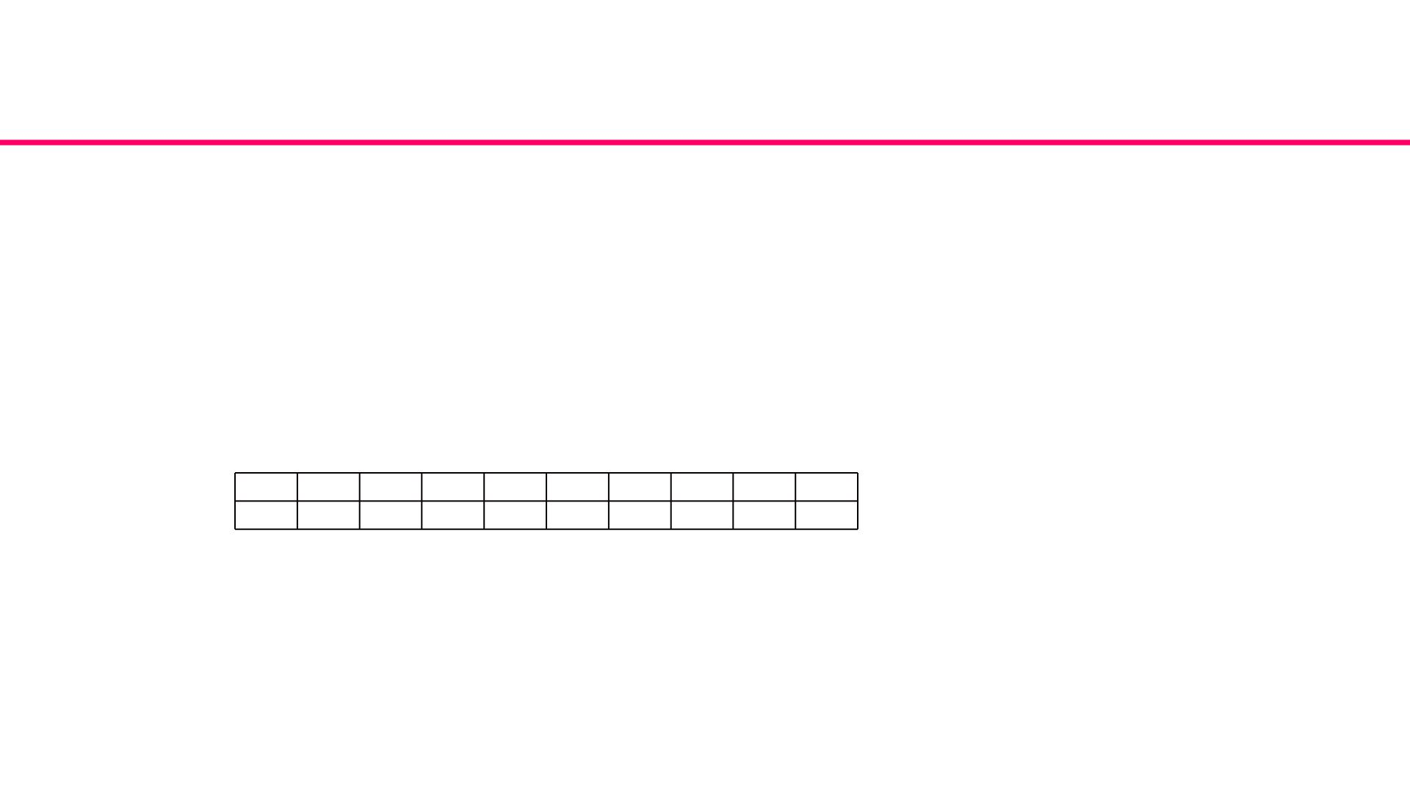
String - Initialization
Example: Consider the following string declaration:char str [10];
When the string "Computer" is assigned to a string variable str, the
characters are stored in the memory as follows:
char str [10] = "Computer";
0
C
1
o
2
M
3
p
4
u
5
t
6
e
7
r
8
\0
9

Slide 37
String - Initialization
/*Program to input and output the string using scanf( ) and printf( ) */
#include<stdio.h>
#include<conio.h>
void main()
{
char name[20];
clrscr();
printf("Enter name\n");
scanf("%s",name);
printf("Name is %s\n",name);
getch();
}

Slide 38
String - Initialization
gets( ) function is used to read the string. It gets the characters typed at the keyboard
until the return key is pressed.
Syntax:
gets(stringvariablename);
puts( ) function is used to print the string type of data.
Syntax:
puts(stringvariablename);

Slide 39
String - Initialization
/*Program to read and write the string using gets( ) and puts( )*/
#include<stdio.h>
void main()
{
char addr[100];
printf("Enter address\n");
gets(addr);
printf("Address is\n");
puts(addr);
}

Slide 40
Array of Strings
A single string is treated as an array of characters. When a list of strings has to be
processed like a list of student names or list of cities, it is represented with two
dimensional arrays.
Declaration: char stdname[20];
char stdname[50][20];
stdname is a matrix containing 50 rows and 20 columns, the rows specifying the
number of names of the students and columns specifying the maximum size of a
name.

Slide 41
Arithmetic operations on characters
Whenever an arithmetic operation is performed on a character constant or character variable,
it is automatically converted to its ASCII equivalent integer value.
Character arithmetic is used to implement arithmetic operations like addition and subtraction
on characters in C language. It is used to manipulate the strings. When the characters are used
with the arithmetic operations, it converts them into integer value automatically i.e. ASCII
value of characters.
Example
char ch=’A’;
printf(“%d”,ch);
will display 65, the ASCII value of A.atoi( ) library function [ASCII to integer] converts a string of
digits to its equivalent integer value.

Slide 42
Arithmetic operations on characters
char ch=’A’ + 1;
printf(“%d”,ch); - Display 66
printf(“%c”,ch); - Display B

Slide 43
Operations on Strings
String oriented library functions are available in <string.h>header file.The operations
that can be performed on string using string functions are,
•Length of the string.
•Concatenation of two strings.
•Copy a string
•Comparison of two strings.
•Substring extraction.

Slide 44
STRING HANDLING FUNCTIONS
1. strcmp( )
General Syntax: strcmp(string1,string2)
This function compares the two strings.If both the strings are equal then the
function returns 0 else it returns –ve value or +ve value.
Example
strcmp(“value”,”value”) will return 0 because both are equal.
strcmp(“ VALUE”,”value”) will return –ve value which is the difference between the
ASCII ’V’ and ASCII ’v ’.
strcmp(“there”,”their ”) will return +ve value which is the difference between ASCII
‘r ’and ASCII ‘i’

Slide 45
STRING HANDLING FUNCTIONS
2.strcmpi( ) function:
This function also compares two strings but not case sensitive. This function
compares the two strings.If both the strings are equal then the function returns 0
else it returns –ve value or +ve value.
General Syntax: strcmpi(“ THE”,”the”) will return 0.
3.strcpy( ) function:
This is used to copy a string to another string.
General Syntax: strcpy(str1,str2);
will copy contents of str2 to str1.

Slide 46
STRING HANDLING FUNCTIONS
4.strcat() function
This is used to concatenate two strings together.
General Syntax: strcat(str1,str2);
concats or joins str2 with str1. The concatenated string is stored in str1.
5.strlen( ) function:
It returns the number of characters in the string.
General Syntax: strlen(str)
will return the number of characters in string str.

Slide 47
STRING HANDLING FUNCTIONS
6. strlwr( )function:
It converts all the characters in a string to lower case.
General Syntax: strlwr(str);
7. strupr( ) function:
It converts all the characters in a string to upper case.
General Syntax:strupr(str);
8.strrev( ) function:
It reverses the characters in a string.
General Syntax:strrev(str);

Slide 48
STRING HANDLING FUNCTIONS
/*Program to find length of a string using the library function. */
#include<stdio.h>
#include<string.h>
void main()
{
char str[100];
int length;
printf("Enter a string\n");
gets(str);
length=strlen(str);
printf("\nNumber of characters in the string is %d",length);
}

Slide 49
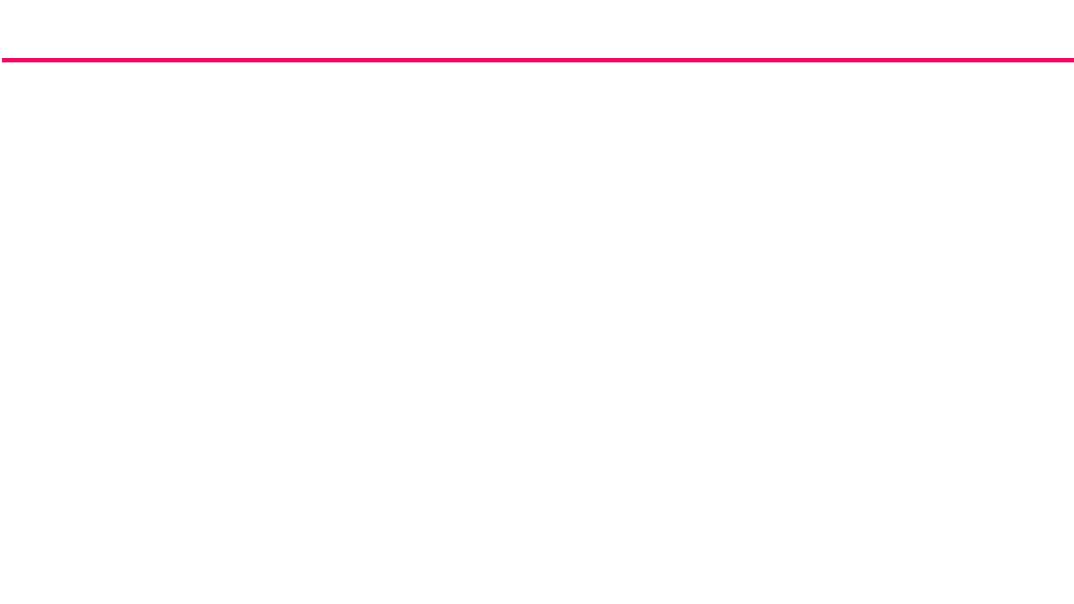
STRING HANDLING FUNCTIONS
/*Program to find the length of a string without using strlen()*/
#include<stdio.h>
#include<conio.h>
void main()
{
char name[20];
int i=0,len;
clrscr();
printf("enter astring\n");
gets(name);
while(name[i]!='\0')
i++;
len=i;
printf("Length of string=%d\n",len);
getch();
}

Slide 50
STRING HANDLING FUNCTIONS
/*Program to accept a string and converts all characters in a string from uppercase to lowercase without using
library function.*/
#include <stdio.h> main()
{
char str[100];
int i=0;
printf ("Enter a string ");
gets(str);
while(str[i]!='\0')
{
if((str[i]>='A') && (str[i] <='Z'))
str[i]=str[i]+32; i++;
}
printf("\nConverted string in lowercase is %s",str);
}

Slide 51
STRING HANDLING FUNCTIONS
/*Program to check if a word is palindrome or not*/
#include<stdio.h>
#include<conio.h>
void main()
{
char str1[10],str2[10];
clrscr();
printf("Enter a string\n");
scanf("%s",str1);
strcpy(str2,str1);
strrev(str2);
if(strcmp(str1,str2)==0)
printf("%s is a palindrome\n",str1);
else
printf("%s is not a palindrome\n",str1);
getch();
}

Slide 52
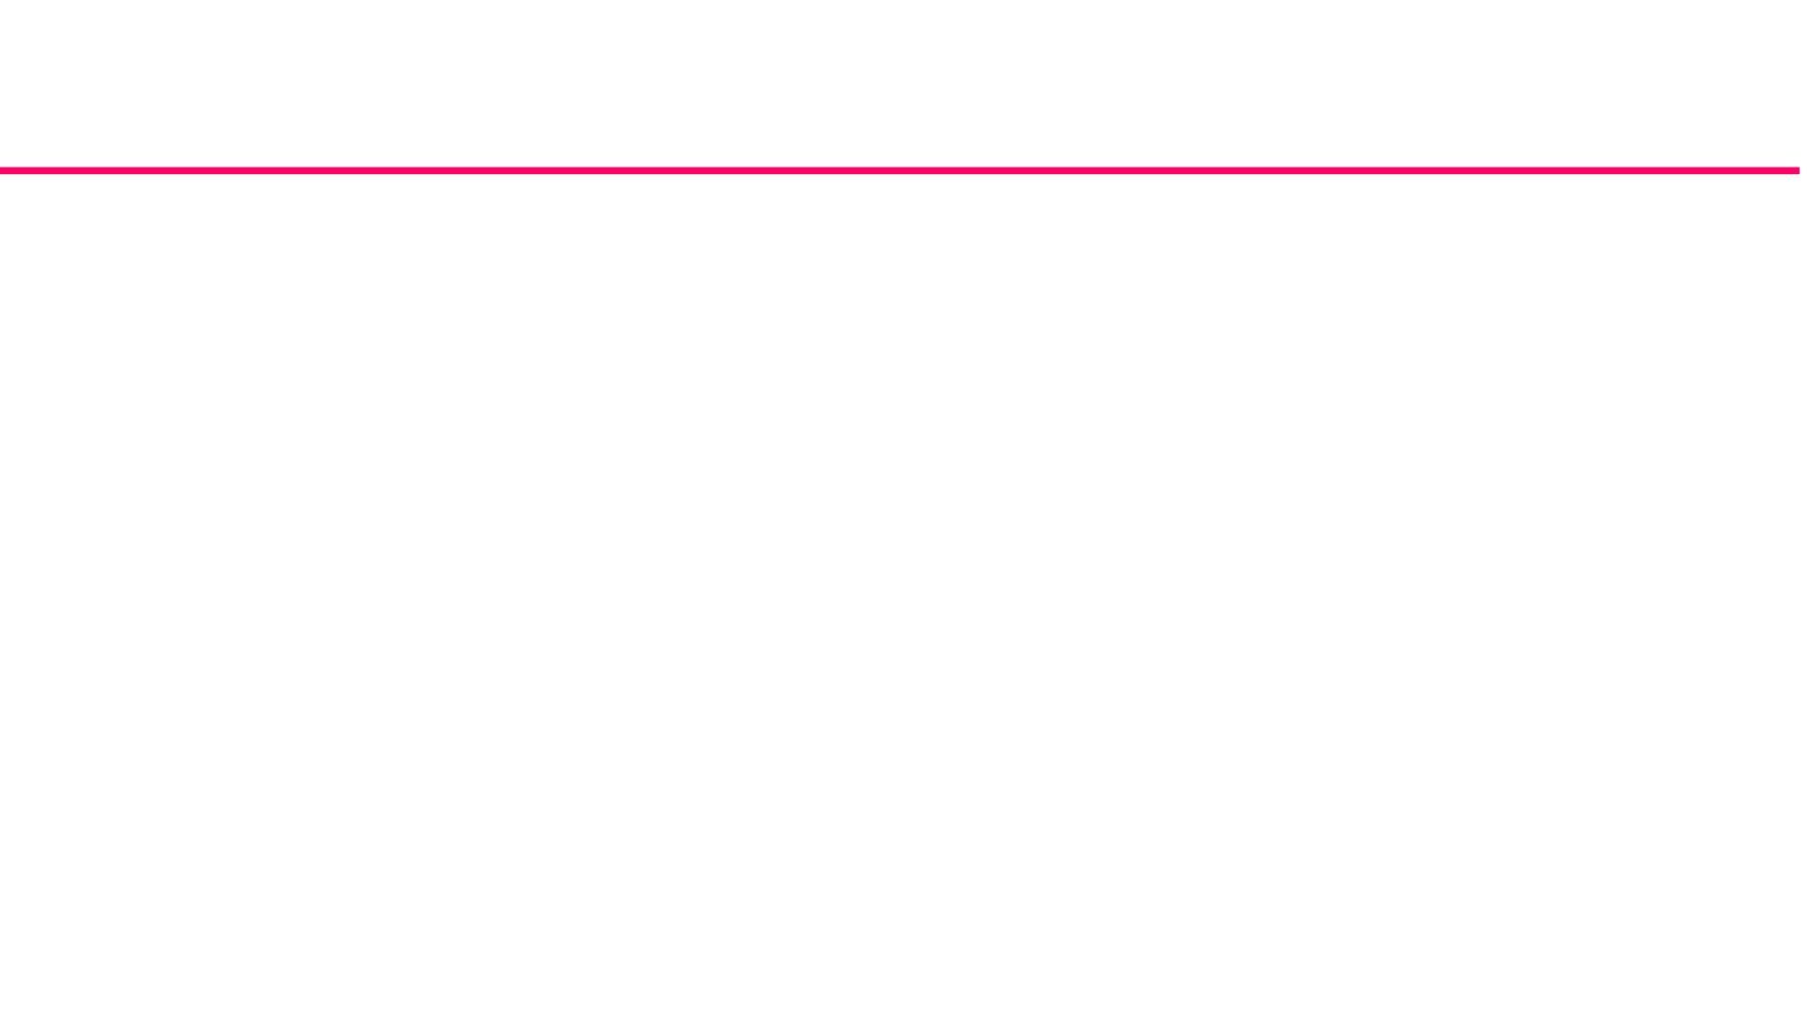
Functions
A function is a named unit of program statements designed to perform a
specific task and returns a single value.
Types of C Functions
1. Library Functions/built-in functions/pre- defined
2. User defined functions
• printf, scanf,strlen,sqrt etc.. belong to library functions or built in functions.
These functions need not be defined by the programmer.
• user defined functions allows a large program to be broken down into a
number of smaller, self-contained components each of which has some
unique, identifiable purpose.

Slide 53
Functions-Advantages
ØMany programs require a particular group of instructions to be accessed
repeatedly from several different places within a program. These repeated
instructions can be placed within a single function which can be accessed
wherever it is needed.
Ø Avoids the need for redundant programming of the same instructions.
Ø Programs with functions are compact.
Ø Debugging is simpler.
Ø Increases readability of the program and helps documentation.
Ø Functions can be used by many other program

Slide 54

Function declaration
Syntax:
returndatatype functionname(datatype [varname1],datatype
[varname2].......datatype [varnameN]);
Example:
product of 2 numbers(input=2 integers,output=1integer)
int productof2(int,int);

Slide 55
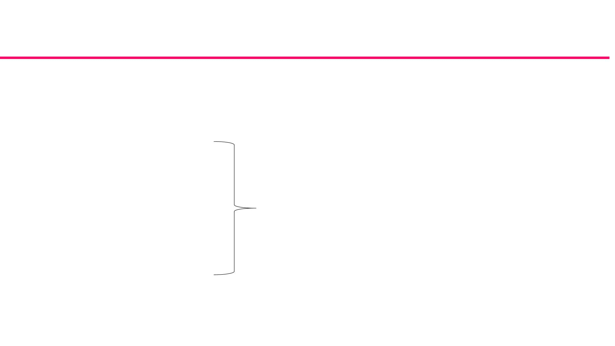
Function Definition
ReturnDatatype function-name (datatype varname1,datatype varname2...datatype varnameN) //type
signature(name,input,output)
{
local variables
Executable Statement-1
Executable Statement-2
Executable Statement-3
body of the function
“
“
[return (Expression)] //[]-optional
}

Slide 56

Function-Call(use/access)
functionname(arguments);

Slide 57
Functions
Example:
int product (x,y) // function header and argument declaration
{
int x,y,p;
p = x * y;
return (p);
// local variable declaration
}
Calling a Function
A function can be called by simply using the function name in a statement.

Slide 58

Functions - Example
#include<stdio.h>
int product(int,int);
void main()
{
int n1,n2,x;
printf("Enter 2 values\n");
scanf("%d %d",&n1,&n2);
x=product(n1,n2); à Function Call
printf("Product of %d and %d =%d\n",n1,n2,x);
getch();
}
//Product function definition
int product(int a,int b)
{
int p;
p=a*b;
return(p);
}

Slide 59
return Statement
Generally, functions will process information passed to it from the calling portion of the
program and return a single value. Information will be passed to the function through
identifiers called arguments (also called actual parameters) and returned with the return
statement.
General format:
return ;
or
return (expression) ;

Slide 60
Actual and Formal Arguments
Actual Arguments:
The functions may be called by a portion of a program with some parameters and these parameters are called
actual arguments.
void main ( )
{
int a,b;
sum (a,b)
-> a and b are actual arguments
}
Formal Arguments
These are the parameters present in the function definition and it may be called dummy arguments or formal
arguments.
sum (int p,int q)
-> p and q are called formal parameters
{
int s;
s=p+q;
printf(“sum=%d\n”,s);
}
The formal arguments may be declared by the same name or different name in the called function but the data
type must be the same in both blocks.

Slide 61
Local and Global Variables
Local variable is defined inside the function block or compound statement.
TGlobal variables are defined outside the main function. They are referred by the same data
type and same name throughout the program in both calling and called program.

Slide 62

/*Program to find the sum of 2 numbers*/
#include<stdio.h>
int add();
int num1,num2,sum;
void main()
-> num1,num2,sum are global variables.
{
printf("Enter 2 numbers\n");
scanf("%d%d",&num1,&num2);
printf("Sum=%d\n",add());
getch();
}
/*add definition*/
int add()
{
sum=num1+num2;
return(sum);
}

Slide 63
RECURSION
Recursion is a powerful programming tool that allows to execute the function repeatedly in
terms of itself. It reduces complexity of the problem by dividing the problem into smaller ones
and solving each smaller one and then grouping them to a big problem. Simple and elegant
programs can be written using recursion.
Recursion is a process of calling a function repeatedly in terms of itself. The repeated calling is
terminated by a specific condition.
Types of Recursions:
Direct Recursion: The function calls itself repeatedly until the condition is satisfied.
Indirect Recursion: The function calls another function which eventually causes the same
function to be called.

Slide 64

Factorial of a Number-Recursion
Factorial of a positive integer n is defined as the product of all integers between n and 1,
denoted by !.
In general, if n = 0 the n! = 1
n > 0 the n! = n * (n-1)!
i.e.) n*(n-1) * (n-2) * ……. *1
Recursive definition :
1
if N = 0
Factorial (N) =
N * Factorial (N-1) otherwise

Slide 65
Factorial of a Number-Recursion
/*Program to find the Factorial of a number .*/
#include<stdio.h>
int fact(int);
void main()
{
/*fact definition*/
int fact(int n)
{
int value=1;
if(n==0)
int num;
printf("Enter the number\n");
scanf("%d",&num);
if(num<0)
return(value);
else
value=n*fact(n-1);
printf("Invalid input\n");
else
return(value);
}
printf("factorial of %d =%d\n",n,fact(num));
getch();
}

